Slide 1

CSE 3521: Introduction to Artificial Intelligence
[Many slides are adapted from the UC Berkeley. CS188 Intro to AI at UC Berkeley and previous CSE 3521 course at OSU.]

Slide 2
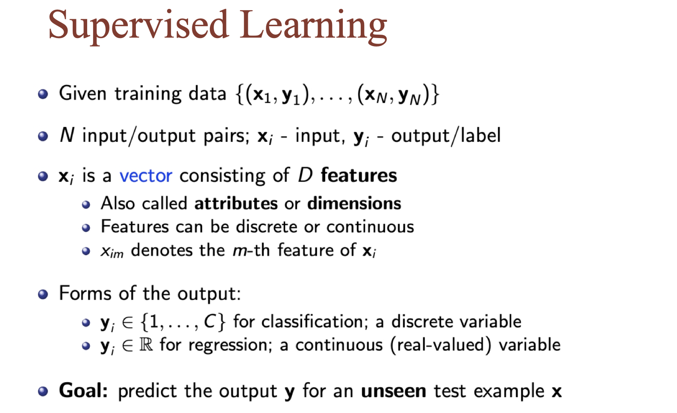

Slide 3
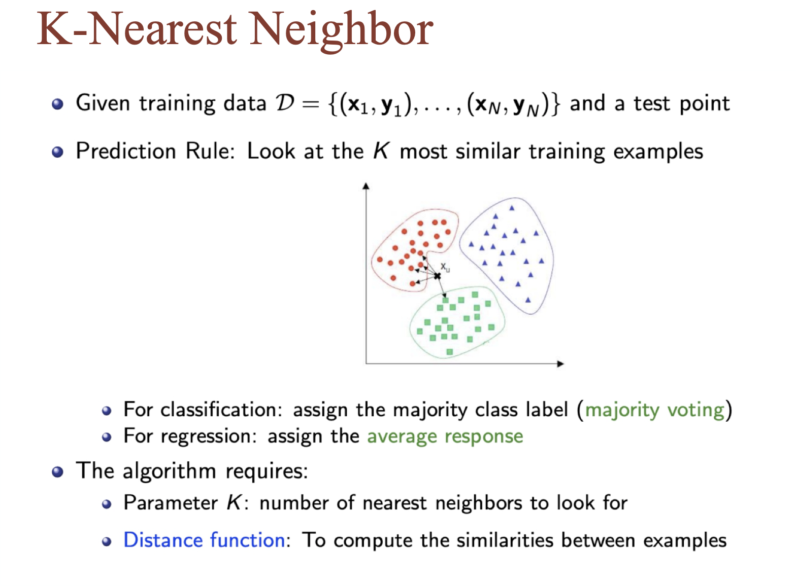

Slide 4
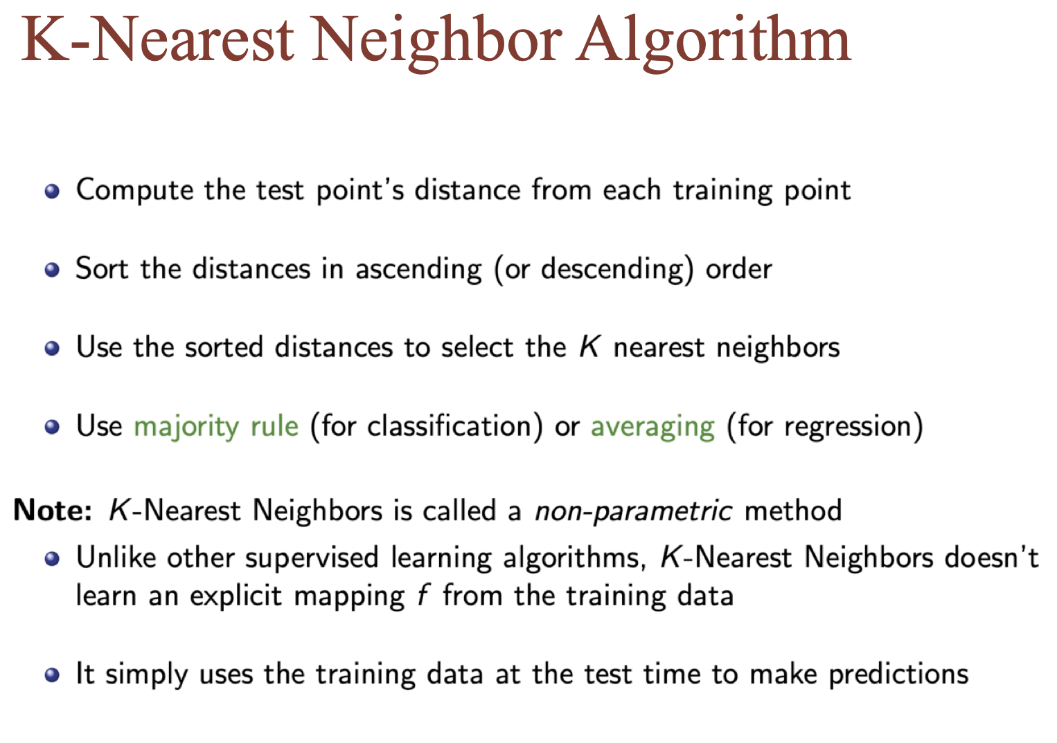

Slide 5
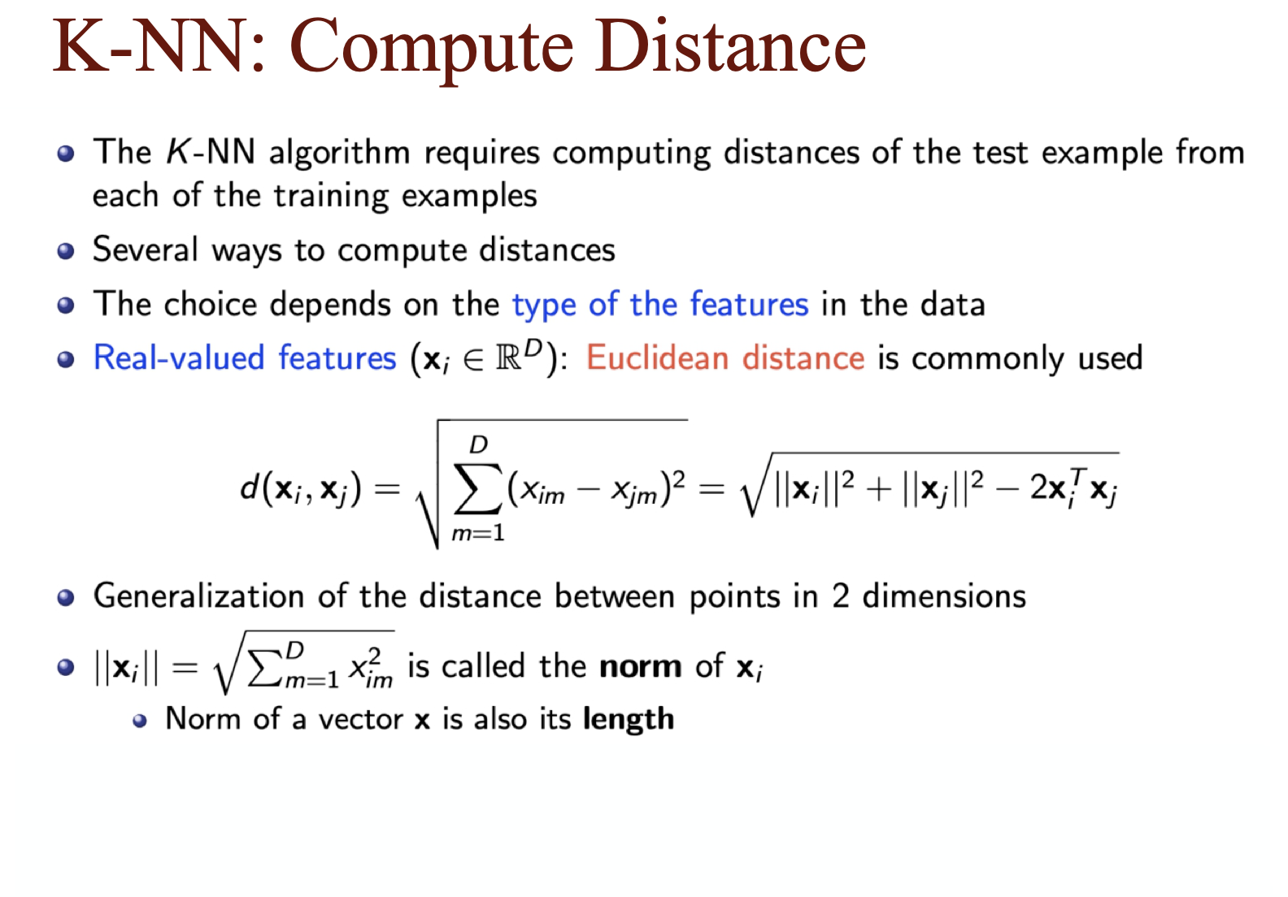

Slide 6
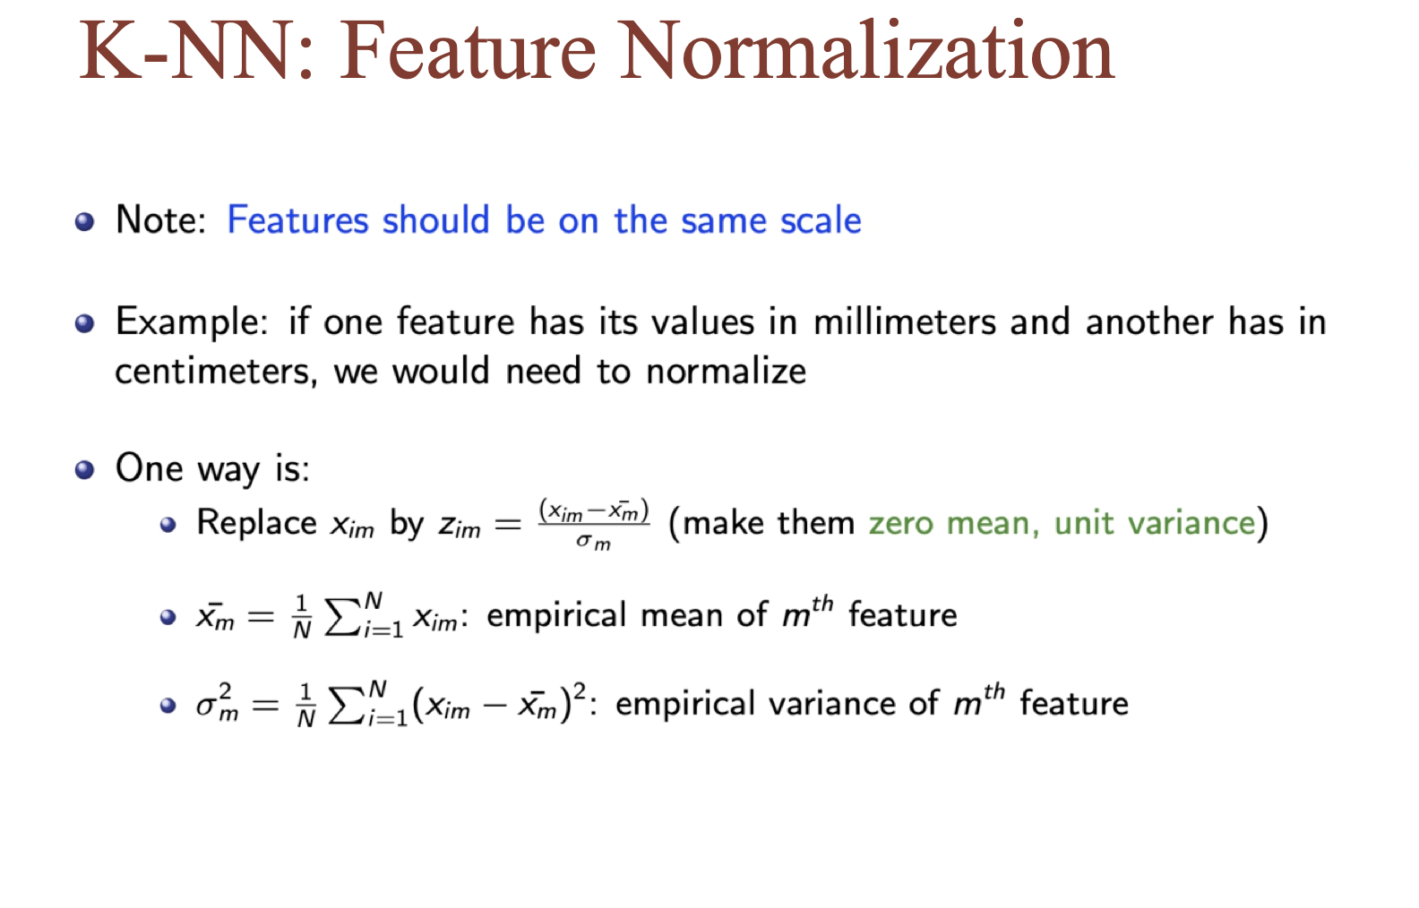

Slide 7
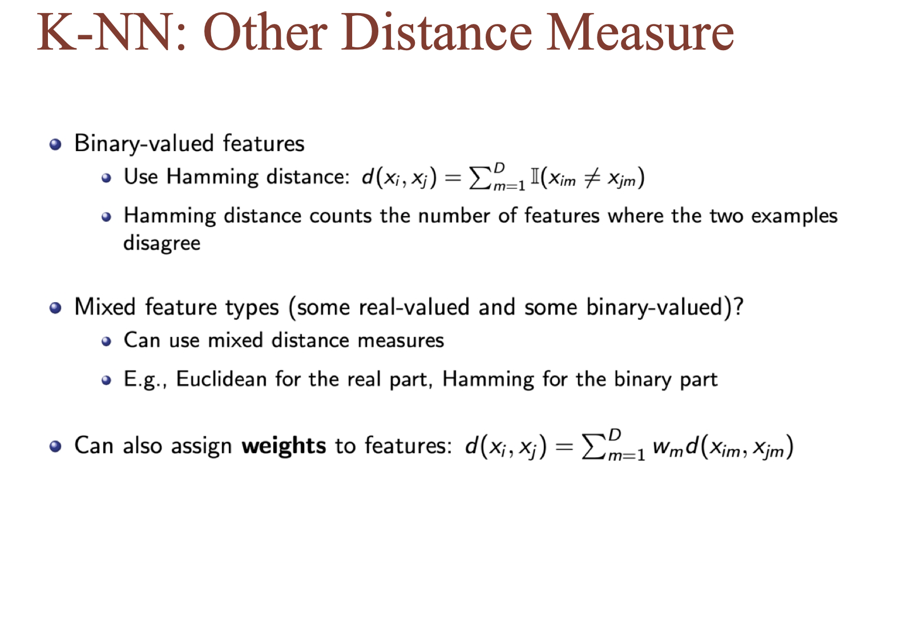

Slide 8
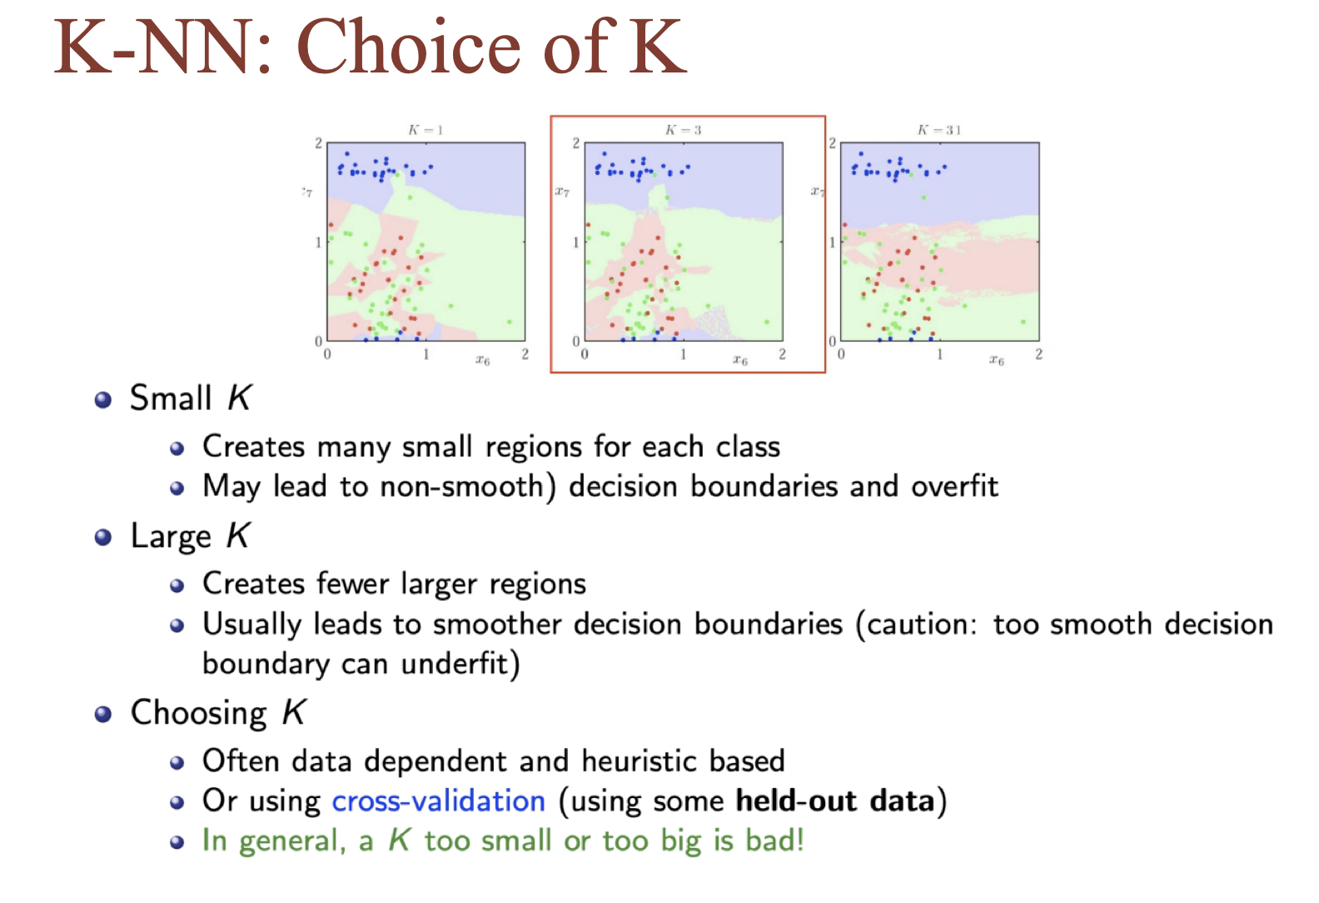

Slide 9
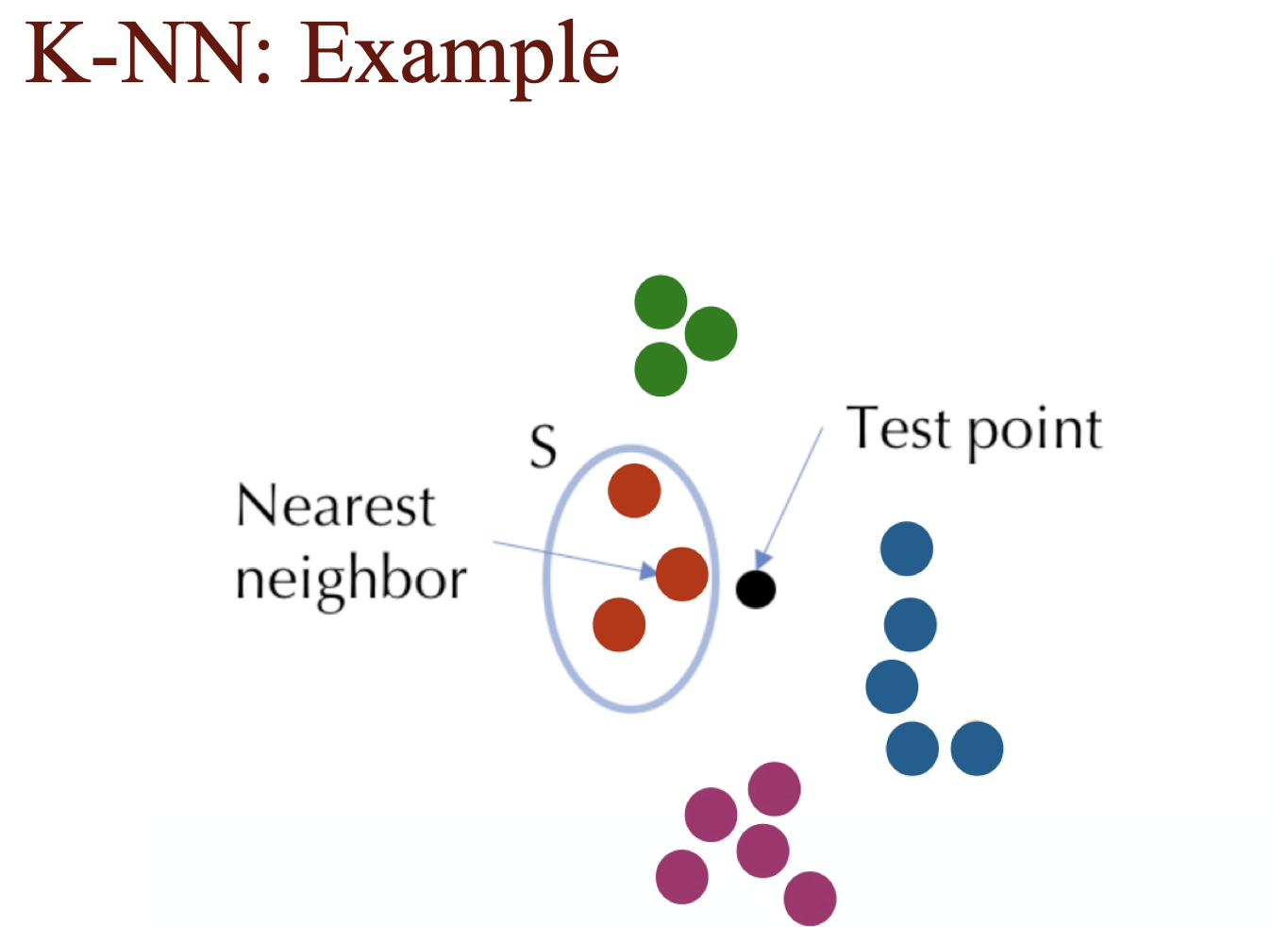

Slide 10
